Slide 1
COSC3503 Section 1 Operating Systems Chapter 1 Introduction
Doug Lim

Slide 2
James 4:6-8 (NIV)
⁶ But he gives us more grace. That is why Scripture says: “God opposes the proud but shows favor to the humble.” ⁷ Submit yourselves, then, to God. Resist the devil, and he will flee from you. ⁸ Come near to God and he will come near to you. Wash your hands, you sinners, and purify your hearts, you double-minded.

Slide 3
Objectives
To describe the basic organization of computer systems.
To provide a grand tour of the major components of operating system

Slide 4
What do operating systems do?
Notes:
Goals
Execute user programs and make solving user problems easier.
Make the computer system convenient to use by providing infrastructure.
Use the computer hardware in an efficient manner.
Often depend on the purpose of the OS

Slide 5
Operating System Definition (Minimum)
OS is an intermediary between hardware and user.
OS is a resource allocator
Manages all resources
Decides between conflicting requests for efficient and fair resource use
OS is a control program
Controls execution of programs to prevent errors and improper use of the computer

Slide 6
Operating System Definitions (Other)
No universally accepted definition
“Everything a vendor ships when you order an operating system” is a good approximation
But varies wildly
“The one program running at all times on the computer” is the kernel.
Everything else is either
a system program (ships with the operating system) , or
an application program.

Slide 7
Computer Startup
Bootstrap program is loaded at power-up or reboot.
Typically stored in ROM or EPROM, generally known as firmware.
Initializes all aspects of the system.
Loads operating system kernel and starts execution.

Slide 8
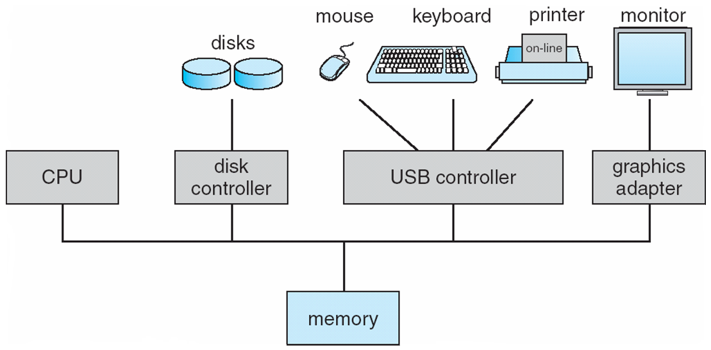
Computer System Organization
One or more CPUs, device controllers connect through common bus providing access to shared memory.
Concurrent execution of CPUs and devices competing for memory cycles.
I/O devices and the CPUs can execute concurrently.
Each device controller is in charge of a particular device type.
Each device controller has a local buffer.
CPU moves data from/to main memory to/from local buffers.
I/O is from the device to the local buffer of the controllers.

Slide 9
Common Functions of Interrupts
Device controllers inform CPU that it has finished its operation by causing and interrupt.
Interrupt transfers control to the interrupt service routine generally, through the interrupt vector, which contains the addresses of all the service routines
Interrupt architecture must save the address of the interrupted instruction
A trap or exception is a software-generated interrupt caused either by an error or a user request
An operating system is interrupt driven

Slide 10
Interrupt Handling
The operating system preserves the state of the CPU by storing registers and the program counter
Determines which type of interrupt has occurred:
Polling
Vectored interrupt system
Separate segments of code determine what action should be taken for each type of interrupt

Slide 11
Storage Definitions and Notation Review
The basic unit of computer storage is the bit. A bit can contain one of two values, 0 and 1. All other storage in a computer is based on collections of bits. Given enough bits, it is amazing how many things a computer can represent: numbers, letters, images, movies, sounds, documents, and programs, to name a few. A byte is 8 bits, and on most computers it is the smallest convenient chunk of storage. For example, most computers don’t have an instruction to move a bit but do have one to move a byte. A less common term is word, which is a given computer architecture’s native unit of data. A word is made up of one or more bytes. For example, a computer that has 64-bit registers and 64-bit memory addressing typically has 64-bit (8-byte) words. A computer executes many operations in its native word size rather than a byte at a time.
Computer storage, along with most computer throughput, is generally measured and manipulated in bytes and collections of bytes.
A kilobyte, or KB, is 1,024 bytes
a megabyte, or MB, is 1,024² bytes
a gigabyte, or GB, is 1,024³ bytes
a terabyte, or TB, is 1,024⁴ bytes
a petabyte, or PB, is 1,024⁵ bytes
Computer manufacturers often round off these numbers and say that a megabyte is 1 million bytes and a gigabyte is 1 billion bytes. Networking measurements are an exception to this general rule; they are given in bits (because networks move data a bit at a time).

Slide 12
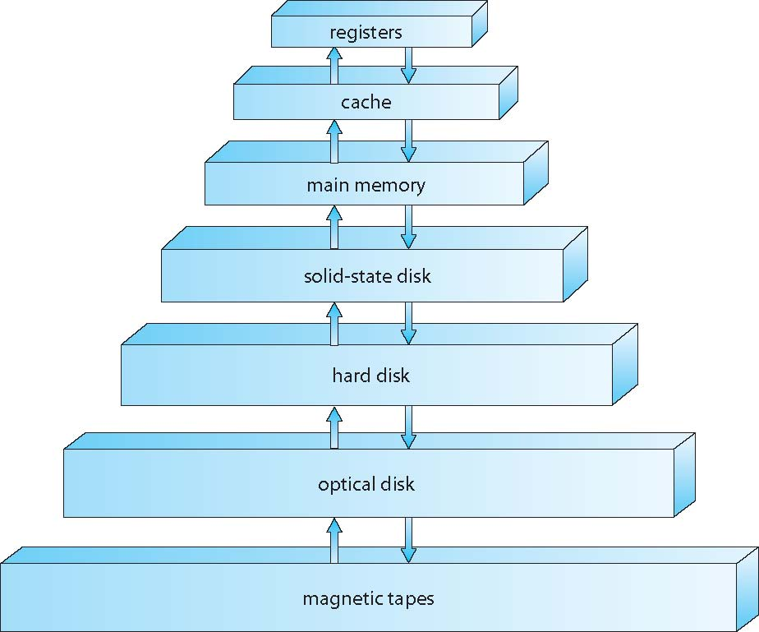
Storage-Device Hierarchy
Notes:
Storage systems organized in hierarchy.
Speed
Cost
Volatility
Caching
Device driver for each device controller to manage I/O
Provides uniform interface and abstraction between controller and kernel.

Slide 13
Caching
Important principle, performed at many levels in a computer (in hardware, operating system, software)
Information in use copied from slower to faster storage temporarily
Faster storage (cache) checked first to determine if information is there
If it is, information used directly from the cache (fast)
If not, data copied to cache and used there
Cache smaller than storage being cached
Cache management important design problem
Cache size and replacement policy

Slide 14
Direct Memory Access Structure
Used for high-speed I/O devices able to transmit information at close to memory speeds
Device controller transfers blocks of data from buffer storage directly to main memory without CPU intervention
Only one interrupt is generated per block, rather than the one interrupt per byte

Slide 15
Multiprocessor Computer-System Architecture
Most systems have special-purpose processors.
Multiprocessors systems growing in use and importance
Also known as parallel systems, tightly-coupled systems
Advantages include:
Increased throughput
Economy of scale
Increased reliability – graceful degradation or fault tolerance
Two types:
Asymmetric Multiprocessing – each processor is assigned a specific task.
Symmetric Multiprocessing – each processor performs all tasks

Slide 16
Clustered Systems
Like multiprocessor systems, but multiple systems working together
Usually sharing storage via a storage-area network (SAN)
Provides a high-availability service which survives failures
Asymmetric clustering has one machine in hot-standby mode
Symmetric clustering has multiple nodes running applications, monitoring each other
Some clusters are for high-performance computing (HPC)
Applications must be written to use parallelization
Some have distributed lock manager (DLM) to avoid conflicting operations

Slide 17
Dual-mode Operation
Dual-mode operation allows OS to protect itself and other system components
User mode and kernel mode
Mode bit provided by hardware
Provides ability to distinguish when system is running user code or kernel code
Some instructions designated as privileged, only executable in kernel mode
System call changes mode to kernel, return from call resets it to user
Increasingly CPUs support multi-mode operations
i.e. virtual machine manager (VMM) mode for guest VMs

Slide 18
Process Management
A process is a program in execution. It is a unit of work within the system. Program is a passive entity, process is an active entity.
Process needs resources to accomplish its task
CPU, memory, I/O, files
Initialization data
Process termination requires reclaim of any reusable resources
Single-threaded process has one program counter specifying location of next instruction to execute
Process executes instructions sequentially, one at a time, until completion
Multi-threaded process has one program counter per thread
Typically system has many processes, some user, some operating system running concurrently on one or more CPUs
Concurrency by multiplexing the CPUs among the processes / threads

Slide 19
Process Management Activities
The operating system is responsible for the following activities in connection with process management:
Creating and deleting both user and system processes
Suspending and resuming processes
Providing mechanisms for process synchronization
Providing mechanisms for process communication
Providing mechanisms for deadlock handling

Slide 20
Memory Management
To execute a program all (or part) of the instructions must be in memory
All (or part) of the data that is needed by the program must be in memory.
Memory management determines what is in memory and when
Optimizing CPU utilization and computer response to users
Memory management activities
Keeping track of which parts of memory are currently being used and by whom
Deciding which processes (or parts thereof) and data to move into and out of memory
Allocating and deallocating memory space as needed

Slide 21
Storage Management
OS provides uniform, logical view of information storage
Abstracts physical properties to logical storage unit - file
Each medium is controlled by device (i.e., disk drive, tape drive)
Varying properties include access speed, capacity, data-transfer rate, access method (sequential or random)
File-System management
Files usually organized into directories
Access control on most systems to determine who can access what
OS activities include
Creating and deleting files and directories
Primitives to manipulate files and directories
Mapping files onto secondary storage
Backup files onto stable (non-volatile) storage media
OS activities
Free-space management
Storage allocation
Disk scheduling

Slide 22
Protection and Security
Protection – any mechanism for controlling access of processes or users to resources defined by the OS
Security – defense of the system against internal and external attacks
Huge range, including denial-of-service, worms, viruses, identity theft, theft of service
Systems generally first distinguish among users, to determine who can do what
User identities (user IDs, security IDs) include name and associated number, one per user
User ID then associated with all files, processes of that user to determine access control
Group identifier (group ID) allows set of users to be defined and controls managed, then also associated with each process, file
Privilege escalation allows user to change to effective ID with more rights
Notes:
Dr, Gowing’s classes cover this is much greater detail.

